Slide 1
DEEP LEARNING WITH NEURAL NETWORKS
Ajay Bhat
13/06/2017

Slide 2
Agenda
Neural Networks and Deep Learning
Introduction to Tensorflow
Convolutional Neural Networks
https://ajayb@stash.air-watch.com/scm/~abhat/deep-learning.git

Slide 3
Deep Learning
Use of artificial neural networks that contain more than one hidden layer.
Adaptibility
Variety of applications
Computer Vision
Language translation
Speech recognition

Slide 4

Deep Learning

Slide 5
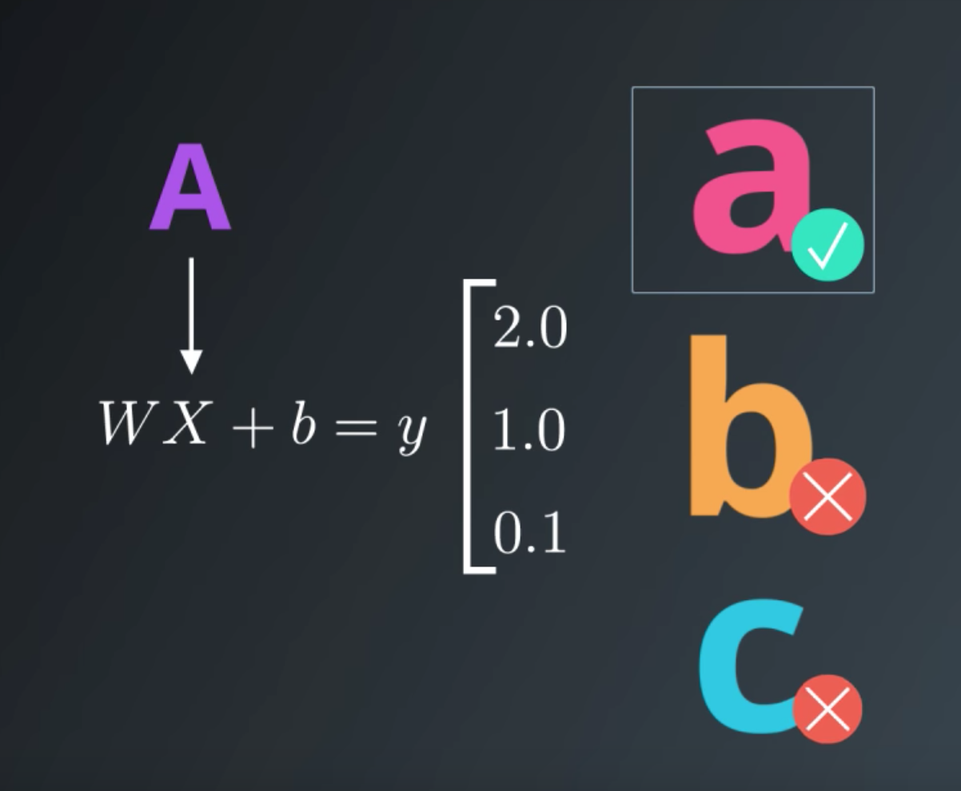
Deep Learning - Logits

Slide 6
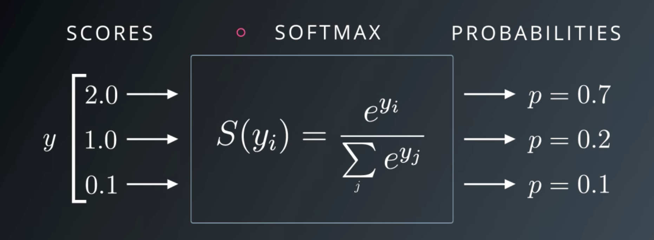
Deep Learning - Softmax function

Slide 7
Introduction to Tensorflow
Library for machine intelligence and numerical computation
https://www.tensorflow.org/

Slide 8
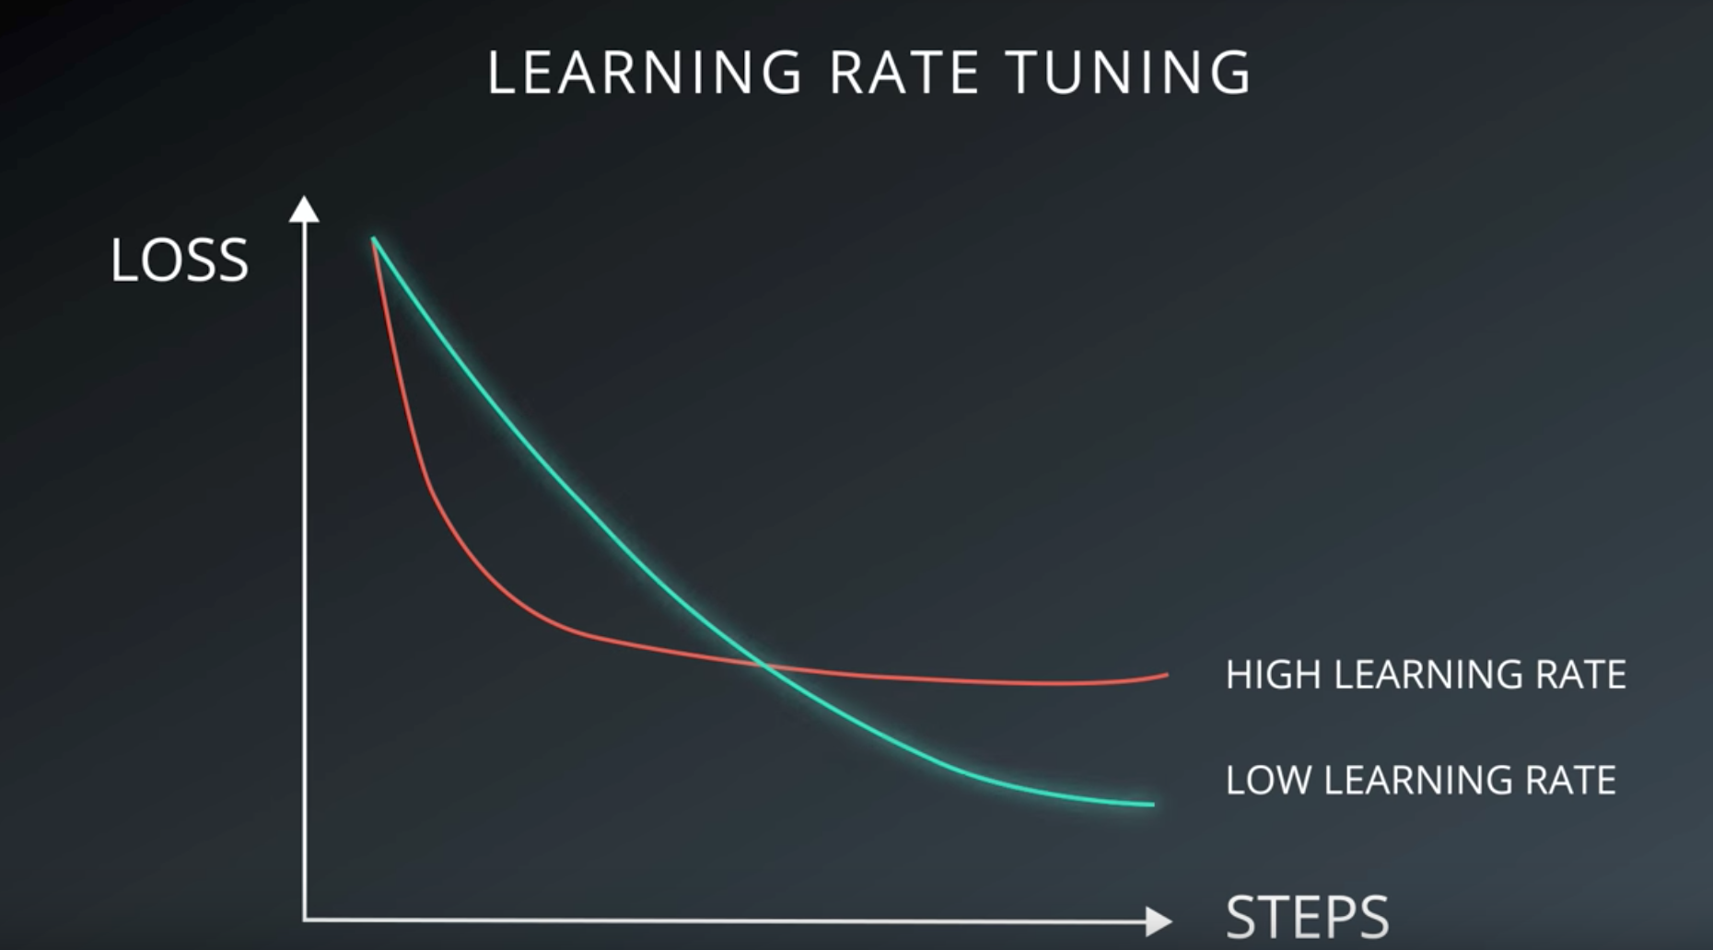
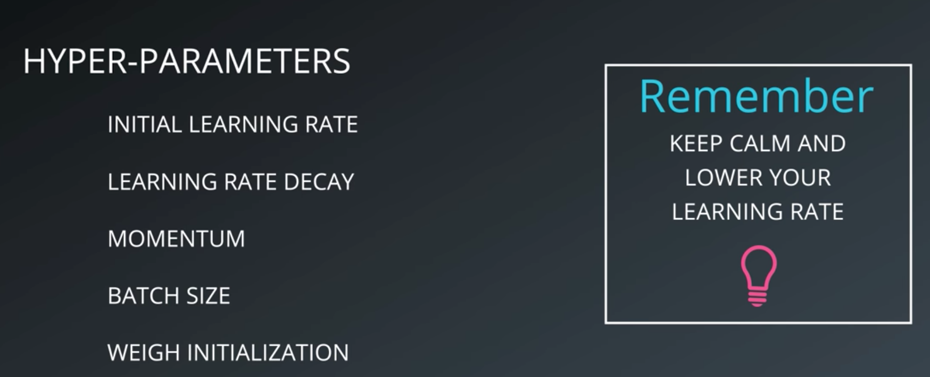
Learning Rate and Hyperparameters

Slide 9
Convolutional Neural Networks

Slide 10
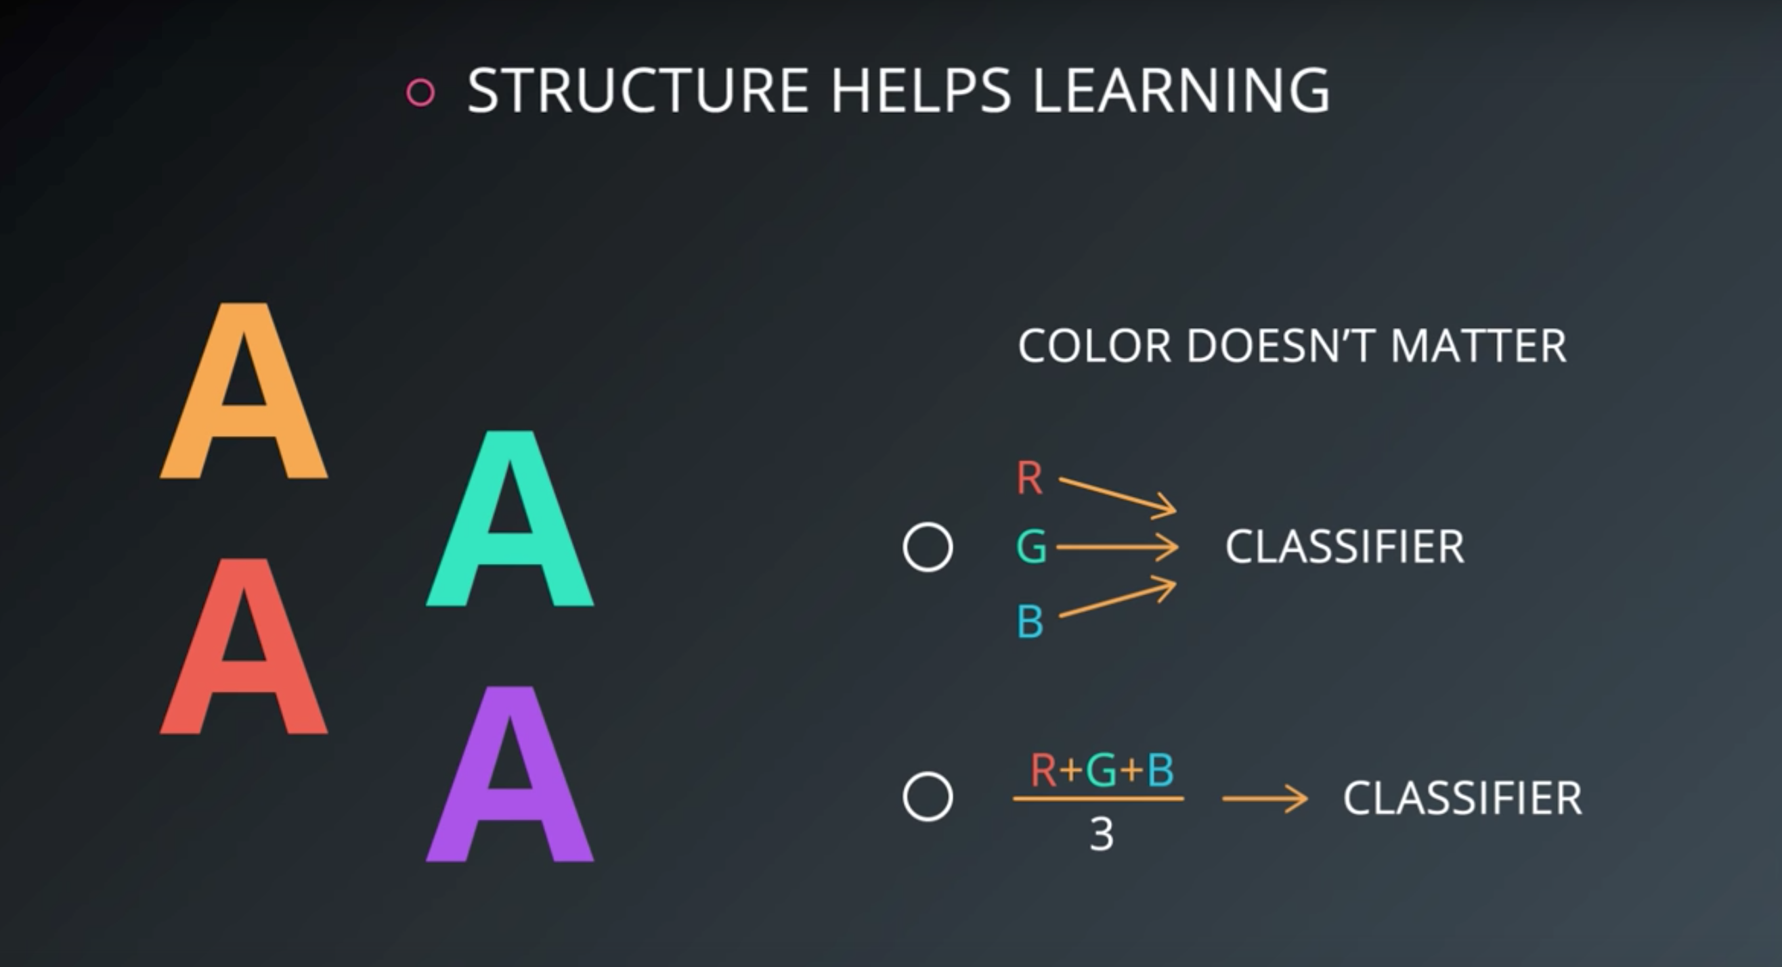
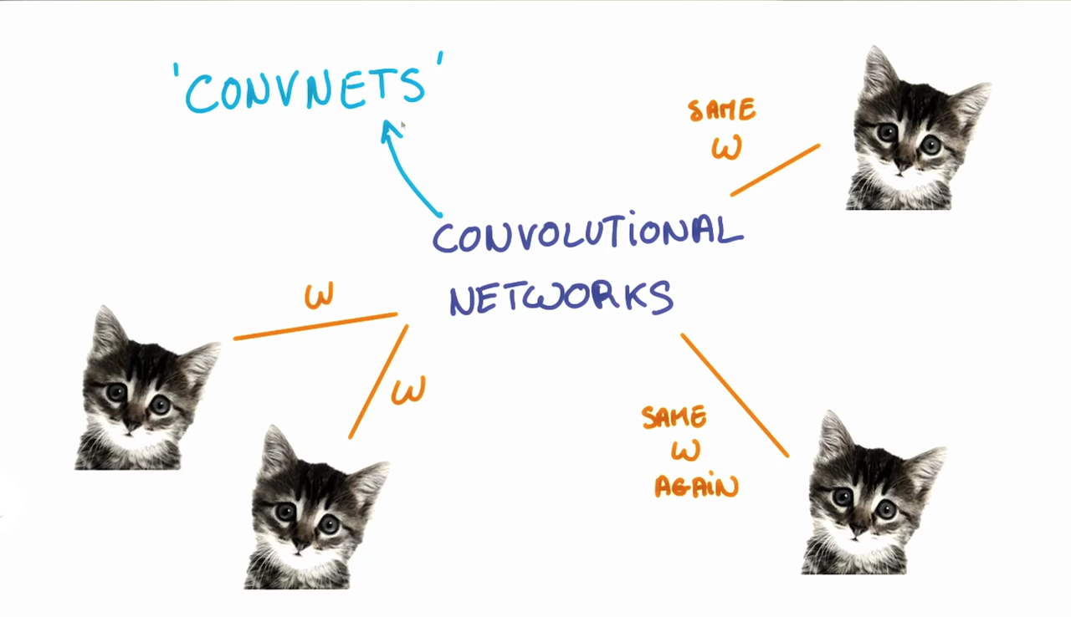
Convolutional Neural Networks - Concept

Slide 11
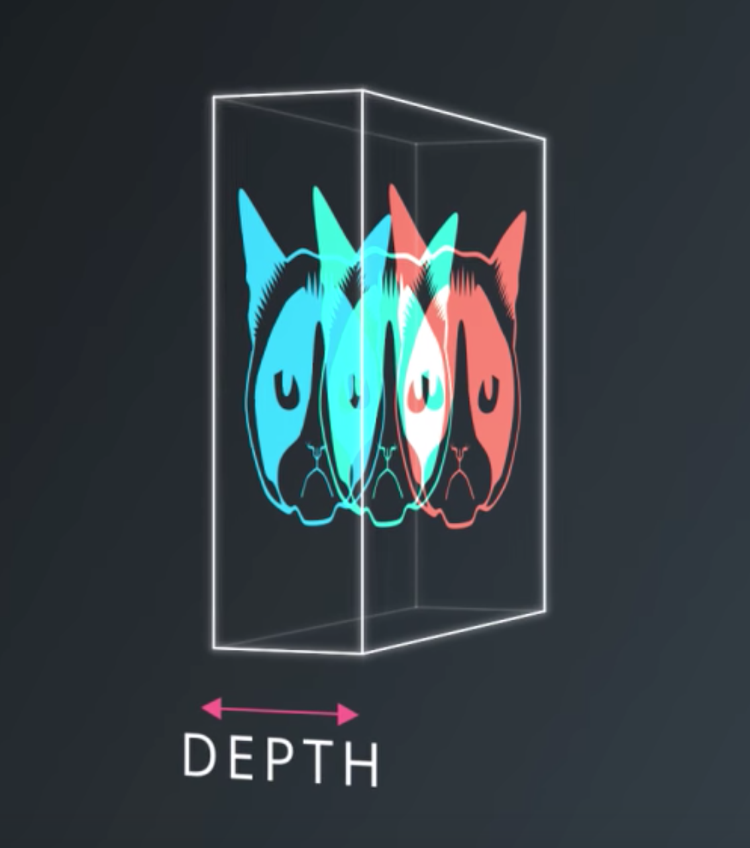
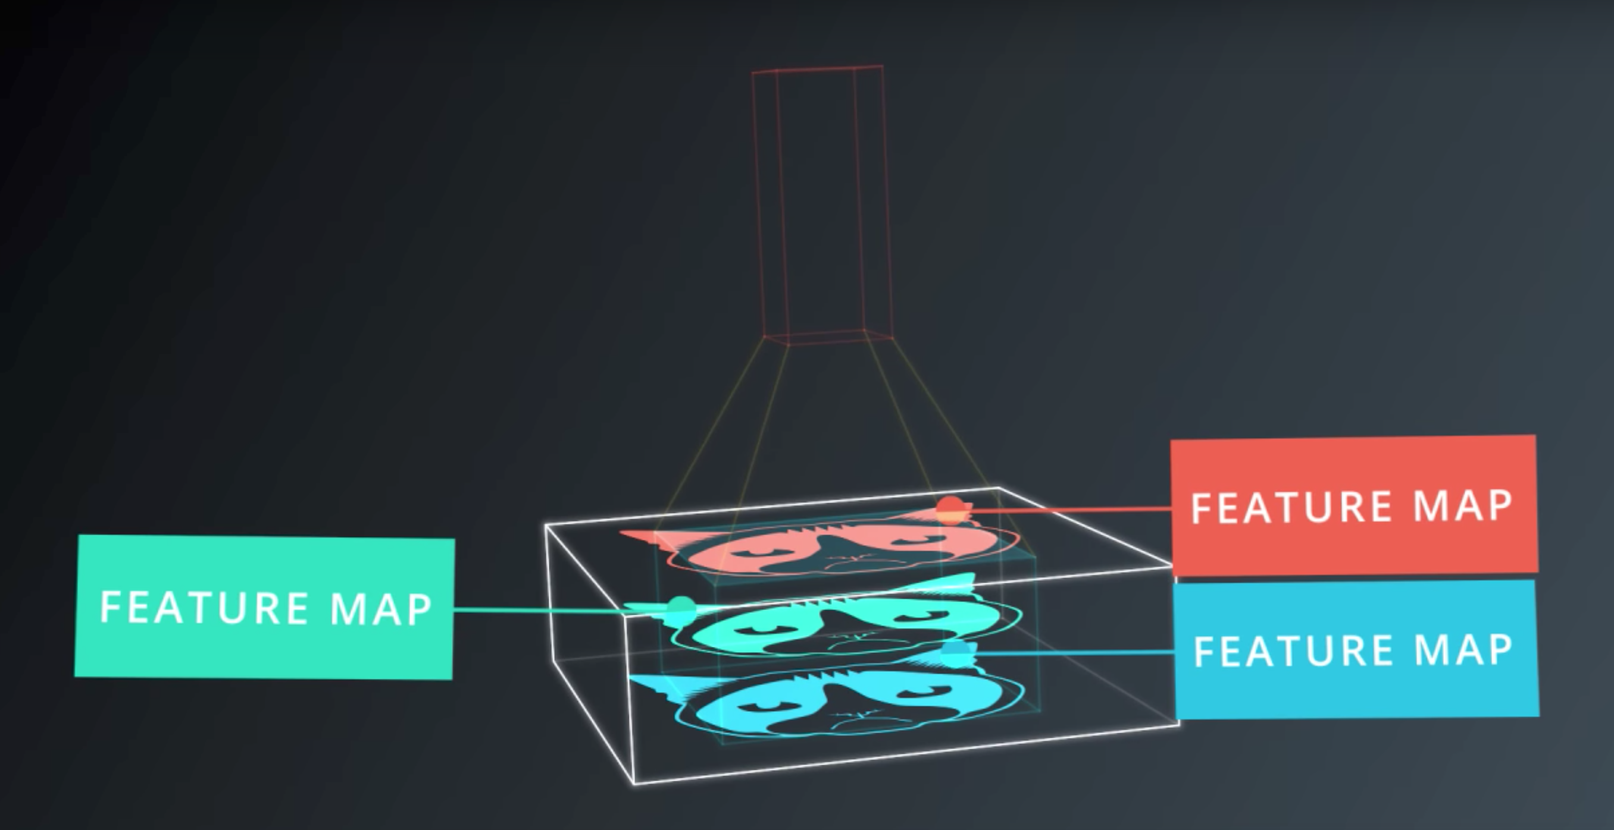
Depth and Feature Map of CovNet

Slide 12
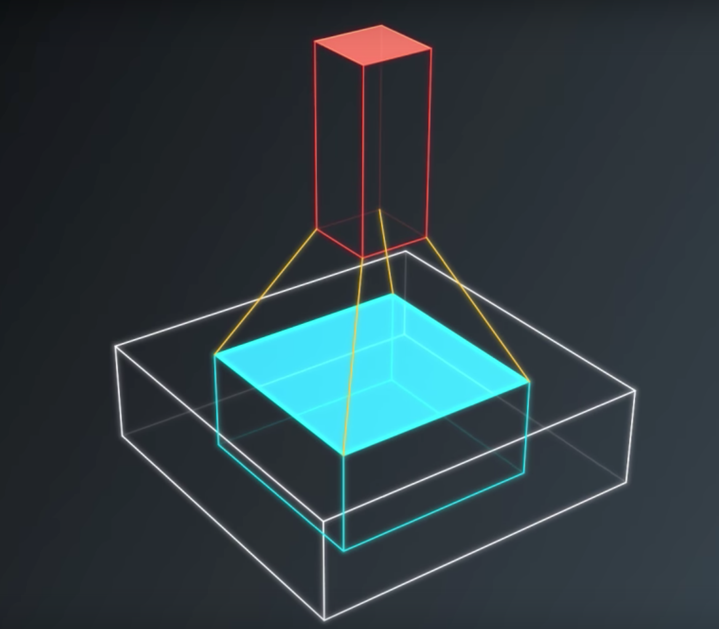
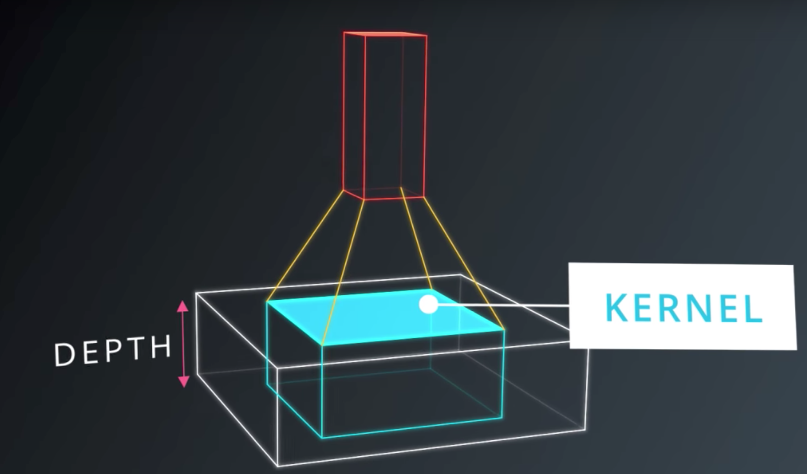
Convolutions

Slide 13
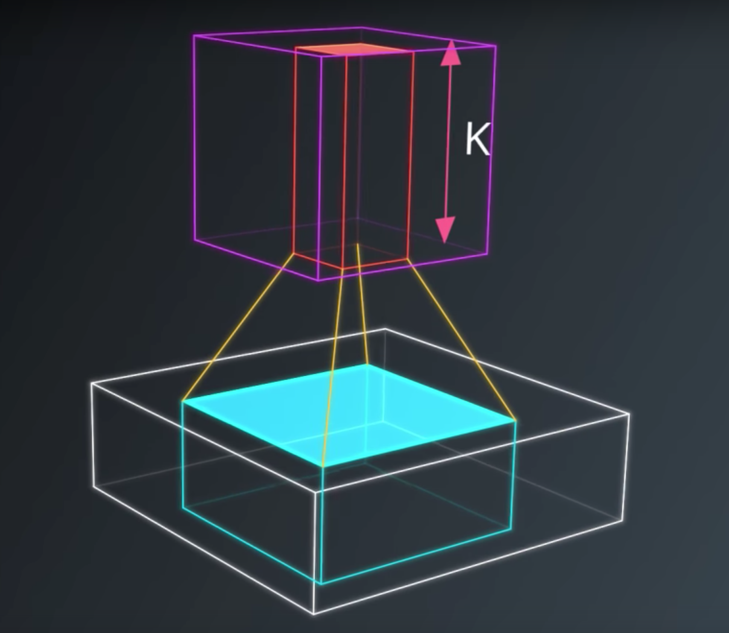
Convolutions

Slide 14
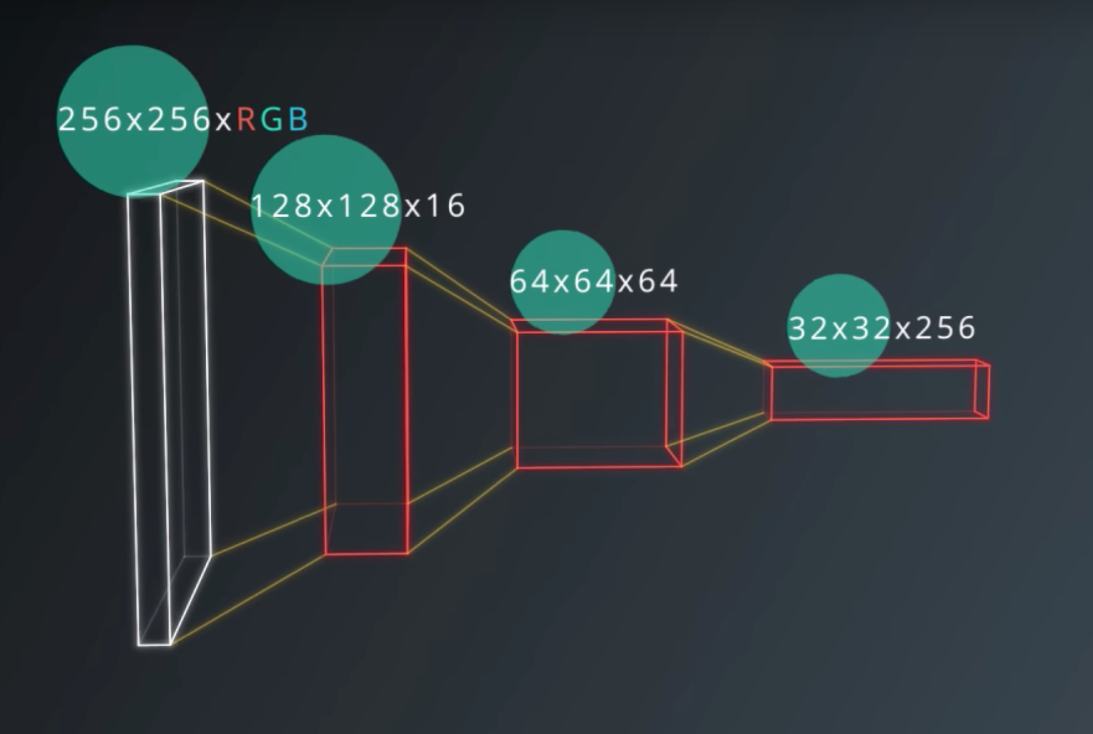
Layers in Convolutions

Slide 15
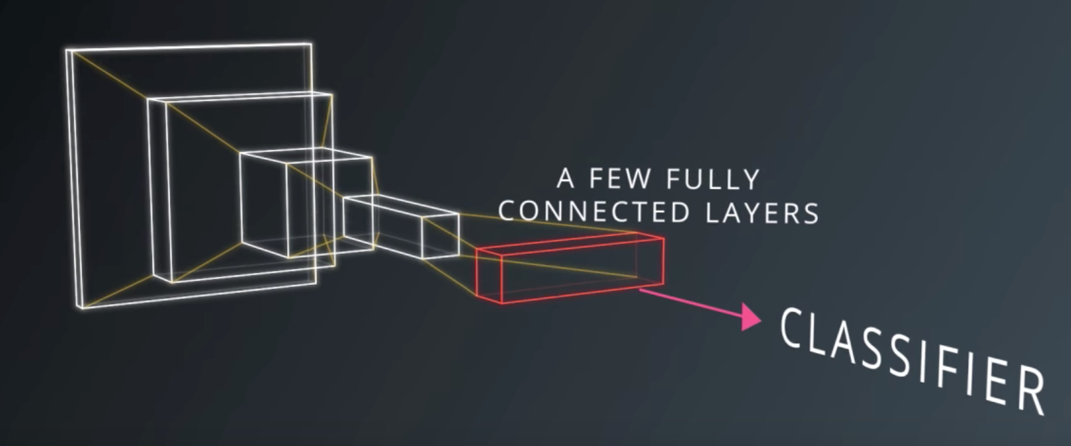
Layers in Convolutions

Slide 16
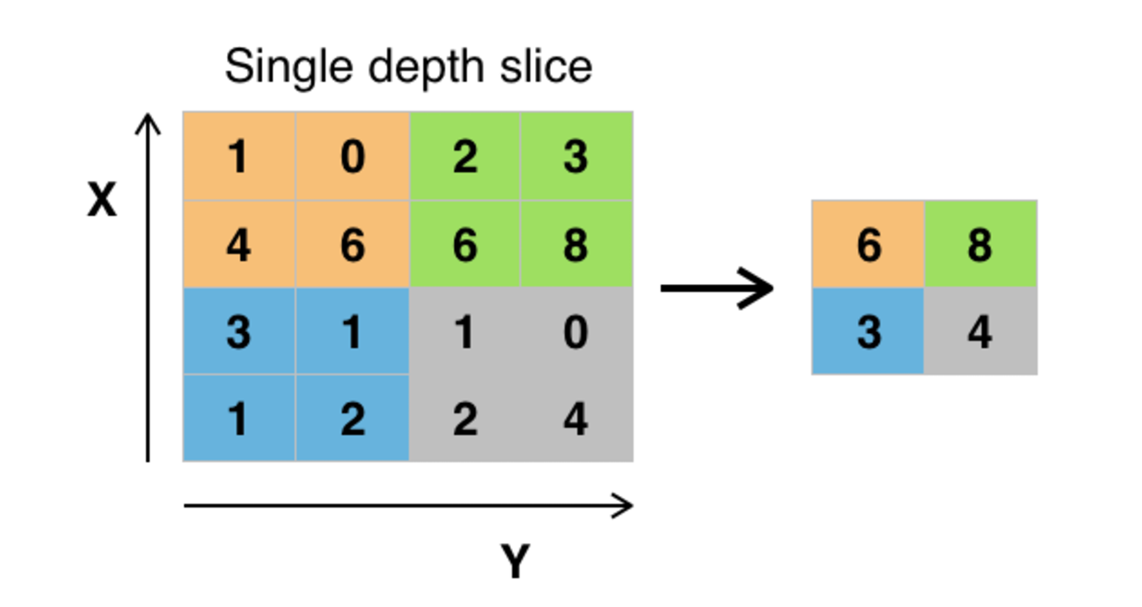
Max Pooling in CovNet

Slide 17
Max Pooling in CovNet
H = height, W = width, D = depth
We have an input of shape 4x4x5 (HxWxD)
Filter of shape 2x2 (HxW)
A stride of 2 for both the height and width (S)
new_height = (input_height - filter_height)/S + 1
new_width = (input_width - filter_width)/S + 1
NOTE: For a pooling layer the output depth is the same as the input depth. Additionally, the pooling operation is applied individually for each depth slice.

Slide 18
Thank You
Further resources:
https://github.com/ajaybhat/Deep-Learning-Workshop
https://en.wikipedia.org/wiki/Convolutional_neural_network
http://cs231n.github.io/convolutional-networks/

